Slide 1
CS 580 – Discussion HW 4 Week 7
Yijing Li
Slides modified from: Matthias Hernandez

Slide 2
Regrading for HW 1-2-3
In your HW 4 submission
Write a README.txt file stating which homeworks you want regraded.
Do not re-submit HW 1, 2 or 3
Please do not ask for regrading if you got 10/10

Slide 3

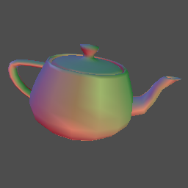

HW 4 goal: add shading
HW 3
HW 4
Flat shading Gouraud shading Phong shading

Slide 4
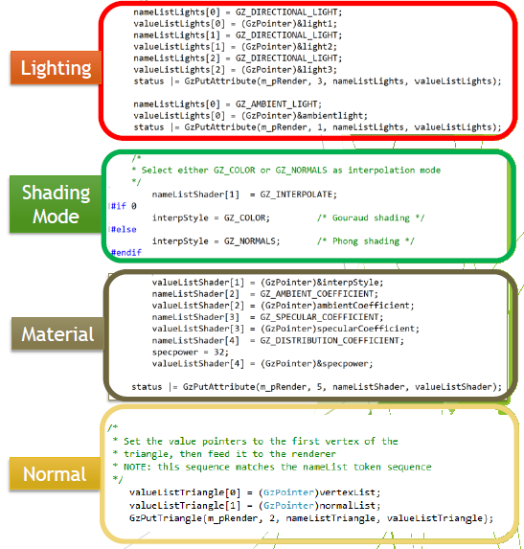
Application4.cpp
New parameters:
- lighting direction
- shading mode
- lighting properties
- normal at each vertex
SECTION TITLE | 2

Slide 5
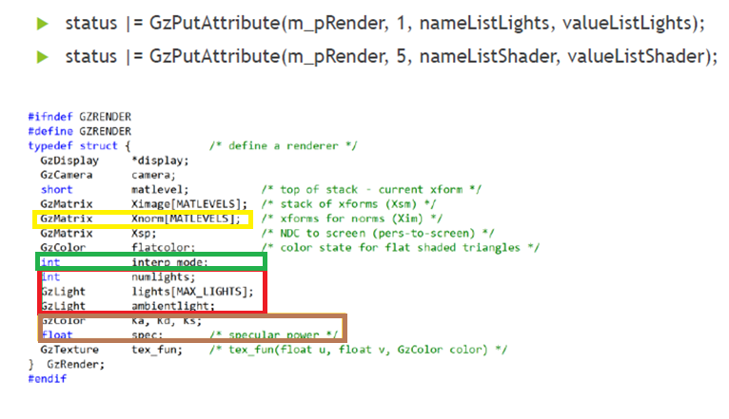
Passing the parameters to the renderer
SECTION TITLE | 2

Slide 6
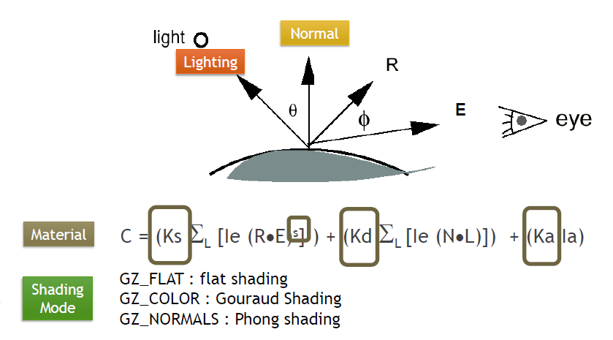
Lighting equation
SECTION TITLE | 2

Slide 7

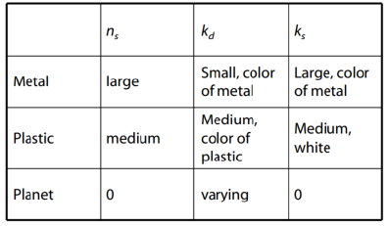

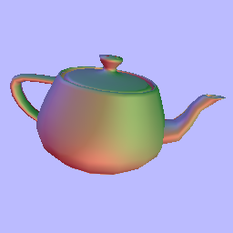

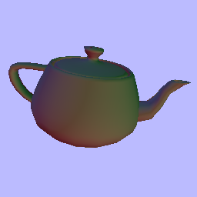

Material
SECTION TITLE | 2

Slide 8
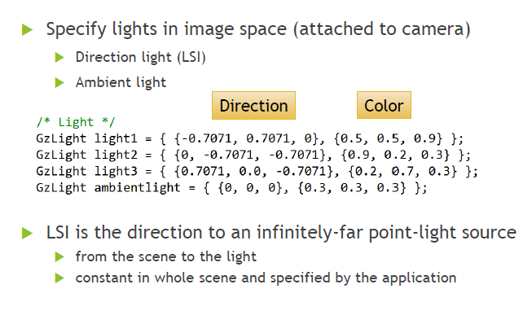
Lighting representation
SECTION TITLE | 2

Slide 9
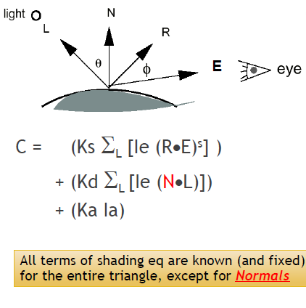
Normals
Normals are provided per vertex in model space
Need to convert to image space with Xwm – Xiw
Keep a 2nd stack for normals (Xnorm)
Xsp and Xpi are Identity
ONLY rotations: no translation/scaling
SECTION TITLE | 2

Slide 10

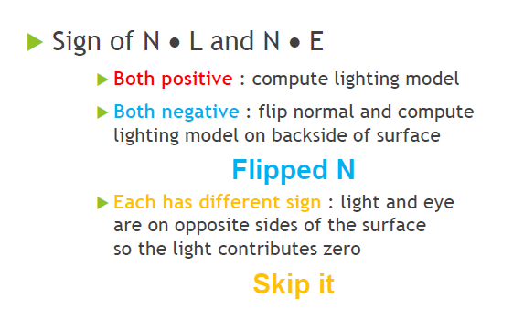
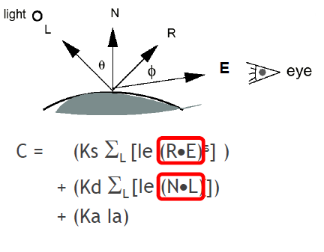
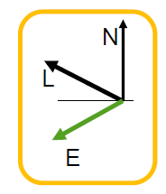
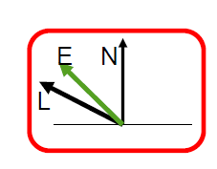
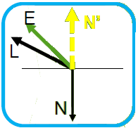
Computing color: orientations
SECTION TITLE | 2

Slide 11
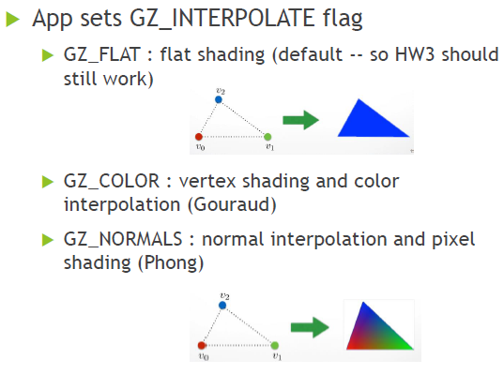
Shading types
Paint the whole triangle with the color from the first vertex (using the normal of the triangle)
Compute color at three vertices
Interpolate color on the triangle
Interpolate normal on the triangle
Compute color at every pixel
Note: Normalize the length of normal!!
SECTION TITLE | 2

Slide 12
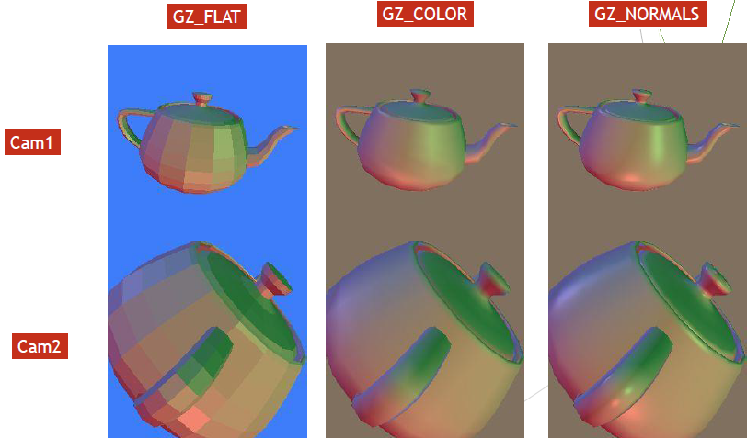
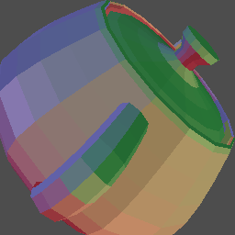
Shading types: results
SECTION TITLE | 2

Slide 13
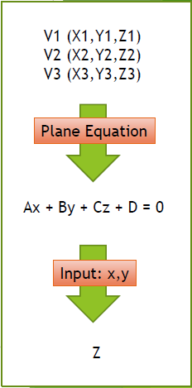

Interpolating
In HW2: interpolating Z
SECTION TITLE | 2

Slide 14
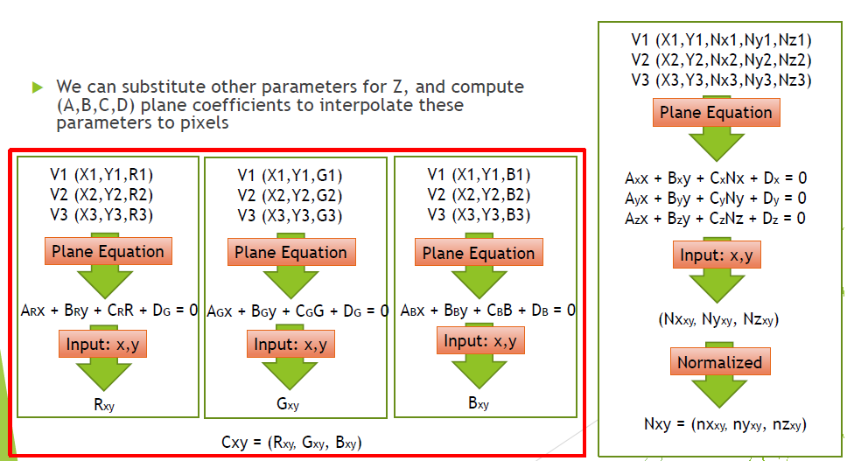
Interpolating with colors/normals
SECTION TITLE | 2

Slide 15
Q&A

